Slide 1
Class-2
Data Science Course

Slide 2
Expected Value
For a probability distribution, the mean of the distribution is known as “Expected Value”.
The expected value intuitively refers to what one would find if they repeated the experiment an infinite number of times and took the average of all of the outcomes.
Mathematically, it’s calculated as a weighted average of each possible value.

Slide 3
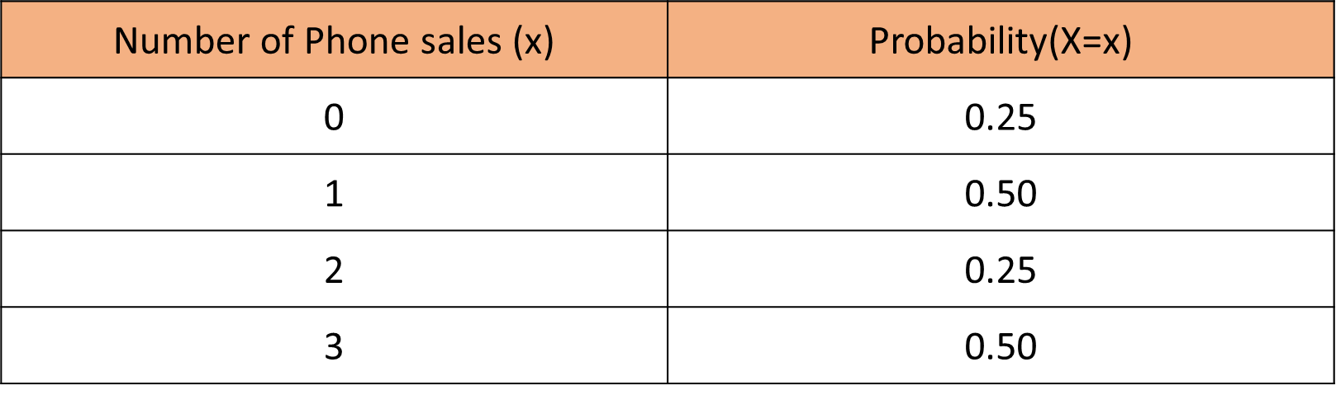
Expected Value

Slide 4
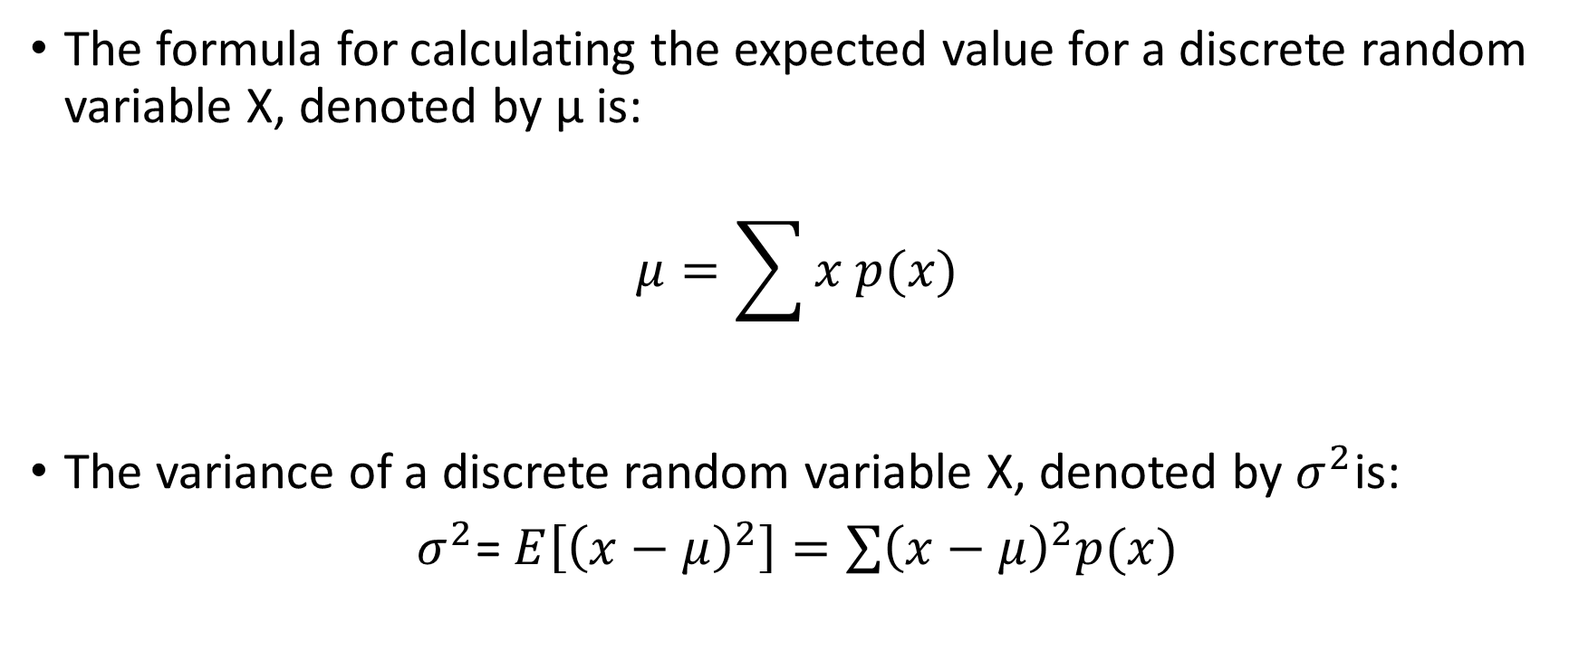
Expected Value
The formula for calculating the expected value for a discrete random variable X, denoted by µ is:
$$μ=\sum{x p(x)}$$
The variance of a discrete random variable X, denoted by $σ^{2}$is:
$σ^{2}$= $E\left[{\left(x−μ\right)}^{2}\right]=\sum{{\left(x−μ\right)}^{2}p(x)}$

Slide 5
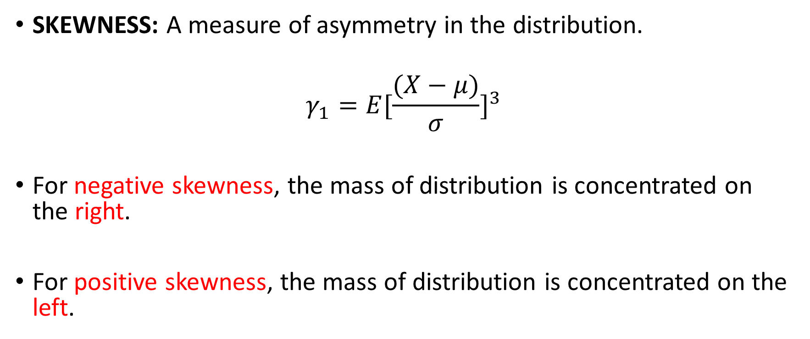
Third Moment Business Decision
SKEWNESS: A measure of asymmetry in the distribution.
$$γ_{1}=E{[\frac{(X−μ)}{σ}]}^{3}$$
For negative skewness, the mass of distribution is concentrated on the right.
For positive skewness, the mass of distribution is concentrated on the left.

Slide 6
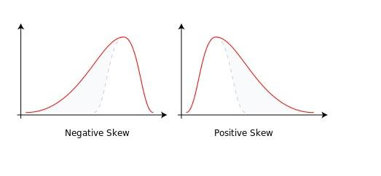
Skewness

Slide 7
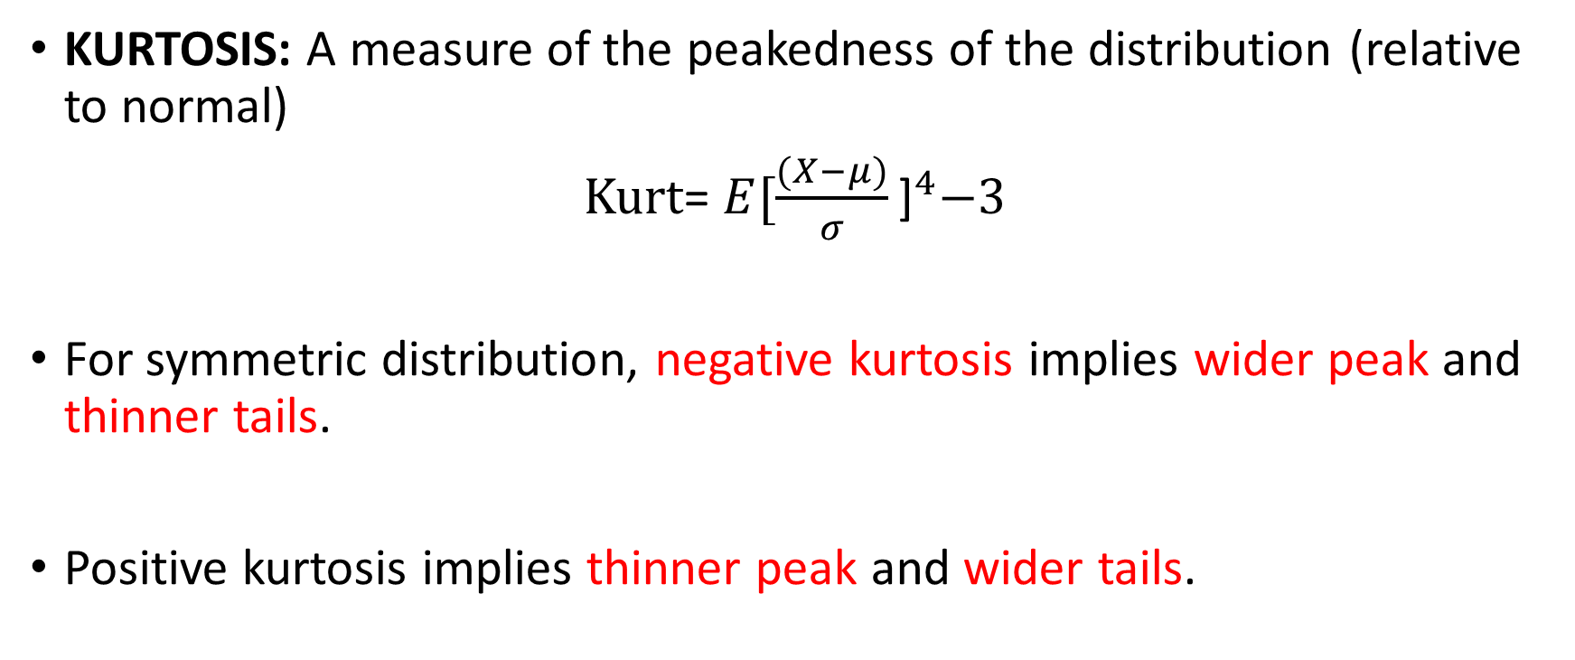
Fourth Moment Business Decision
KURTOSIS: A measure of the peakedness of the distribution (relative to normal)
Kurt= $E{[\frac{(X−μ)}{σ}\text{]}}^{4}−3$
For symmetric distribution, negative kurtosis implies wider peak and thinner tails.
Positive kurtosis implies thinner peak and wider tails.

Slide 8
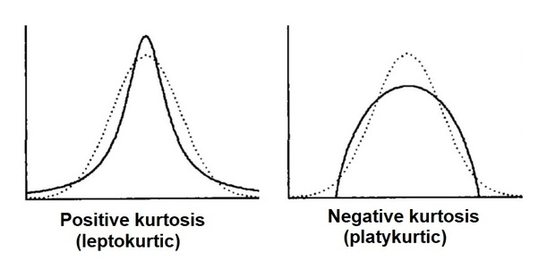
Kurtosis

Slide 9

Introduction to R

Slide 10
Programming language and free software environment for statistical computing and graphics.
Supported by the R Foundation for Statistical Computing.
Interpreted language
Supports matrix arithmetic.
The capabilities of R are extended through user-created packages, which allow specialized statistical techniques, graphical devices, import/export capabilities, reporting tools, etc.

Slide 11
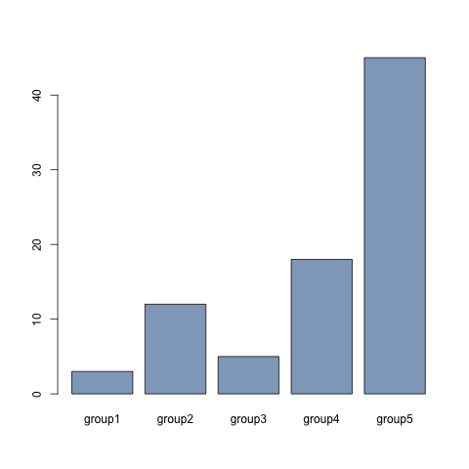
Bar Graph
A bar chart presents categorical data with rectangular bars with heights or lengths proportional to the values that they represent.

Slide 12
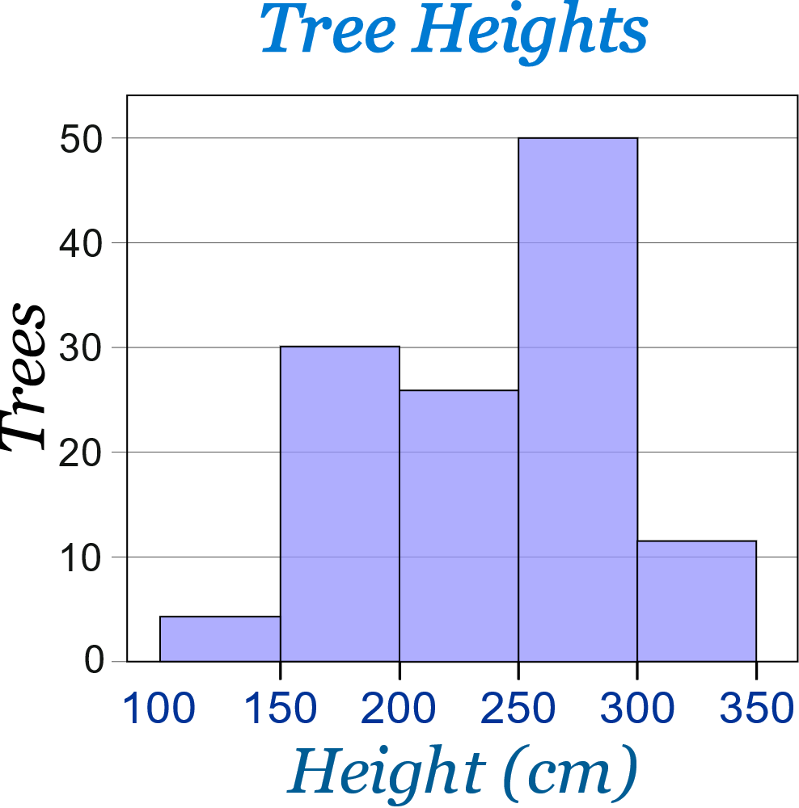
Histogram
A histogram represents the frequency distribution i.e., how many observations take the value to a certain level.

Slide 13
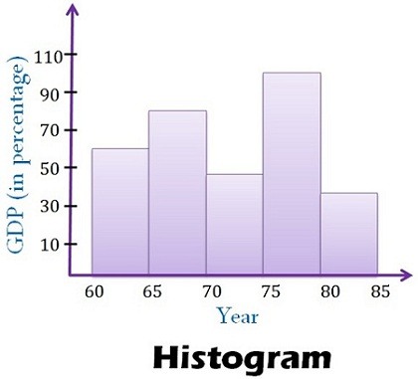
Histogram

Slide 14
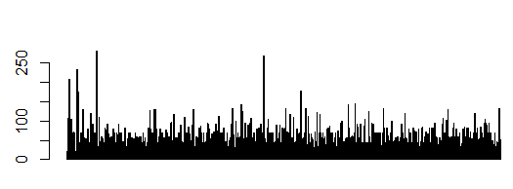
Histogram v/s Bar plot

Slide 15
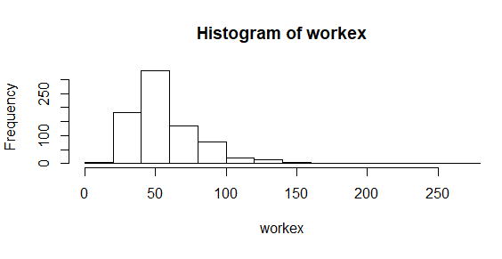
Histogram v/s Bar plot

Slide 16
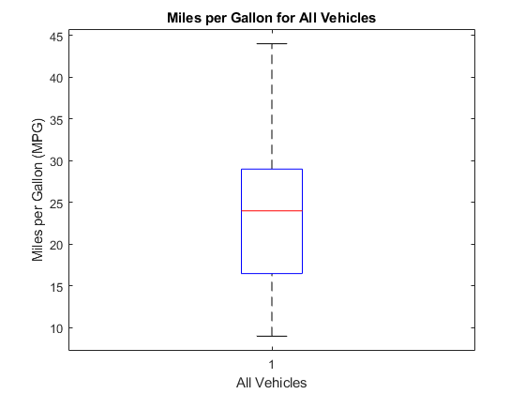
Boxplot
Outlier
Upper Extreme
Q3+1.5(IQR)
Upper Quartile
Median
Lower Quartile
Whisker
IQR
(Interquartile Range)
Q1-1.5(IQR)
Lower Extreme
A box plot or box and whisker plot is a method for graphically depicting groups of numerical data through their quartiles.

Slide 17
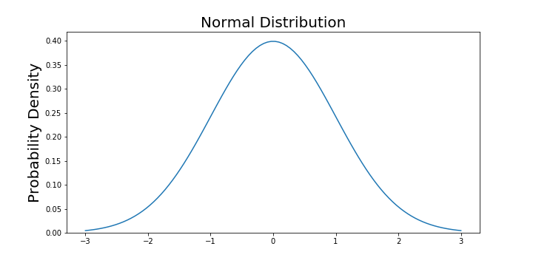
Normal Distribution
The normal distribution is a probability function that describes how the values of a variable are distributed.

Slide 18

Normal Distribution Properties
The normal random variable takes values from $−∞$to $+∞.$
The probability associated with any single value of a random variable is always 0.
Area under entire curve is always 1.

Slide 19
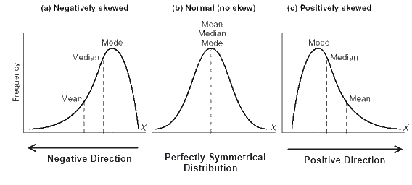
Normal Distribution

Slide 20
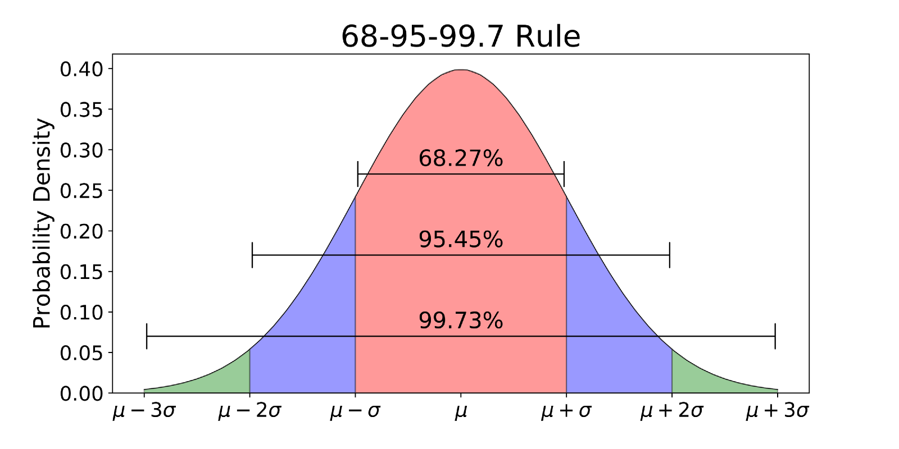
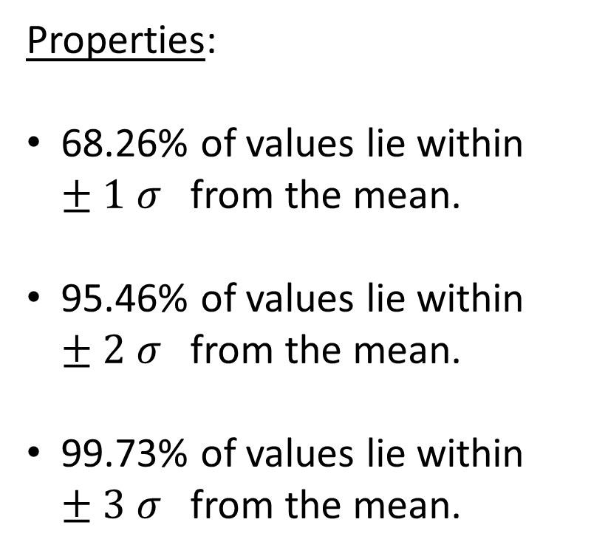
Normal Distribution
Properties:
68.26% of values lie within $±1 σ$from the mean.
95.46% of values lie within $±2 σ$from the mean.
99.73% of values lie within $±3 σ$from the mean.

Slide 21
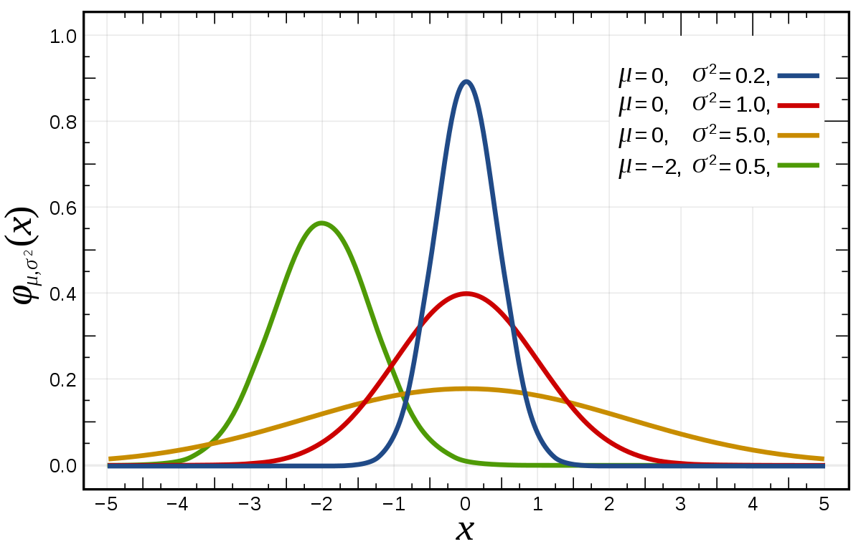
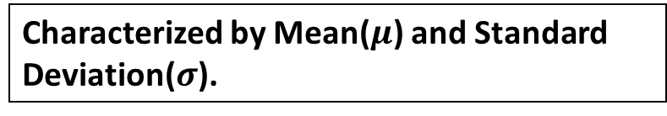
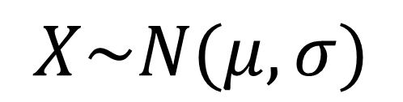
Normal Distribution- Probability Distribution Function
Characterized by Mean($μ$) and Standard Deviation($σ$).
$$X\sim N(μ,σ)$$

Slide 22
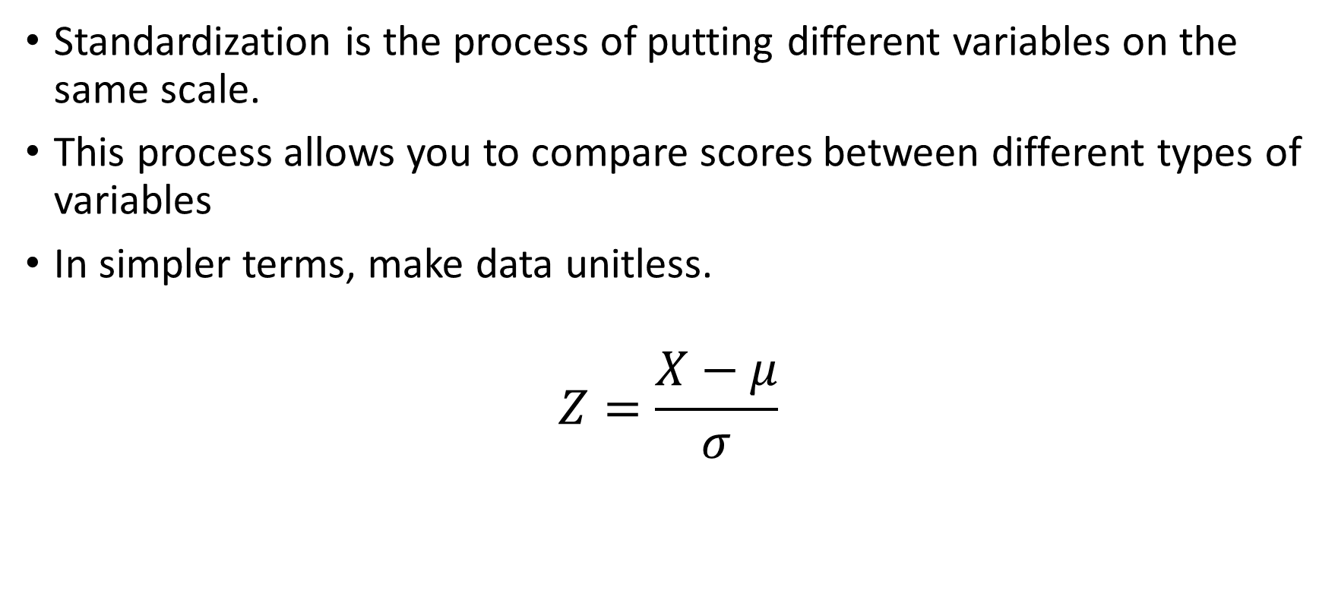
Standard Normal Distribution
Standardization is the process of putting different variables on the same scale.
This process allows you to compare scores between different types of variables
In simpler terms, make data unitless.
$$Z=\frac{X−μ}{σ}$$

Slide 23
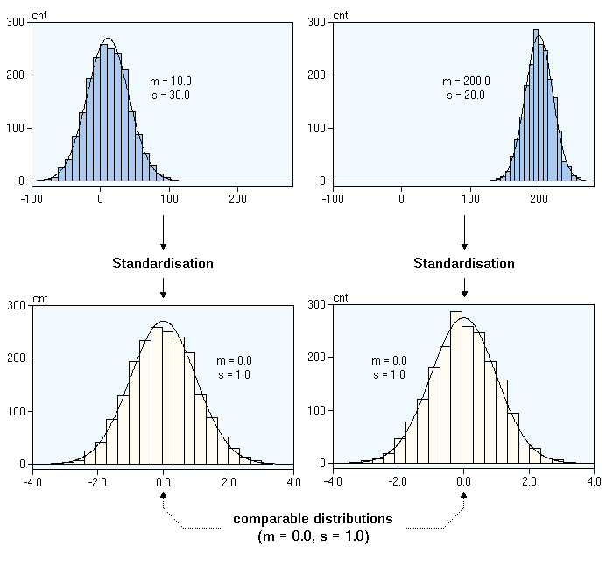
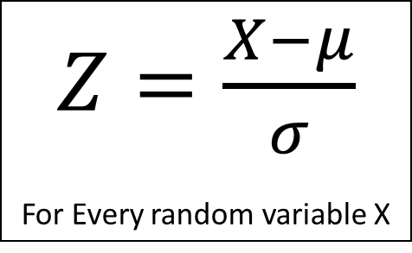
Z-Score
A Z-score is the number of standard deviations from the mean a data point is.
$Z=\frac{X−μ}{σ}$
For Every random variable X

Slide 24
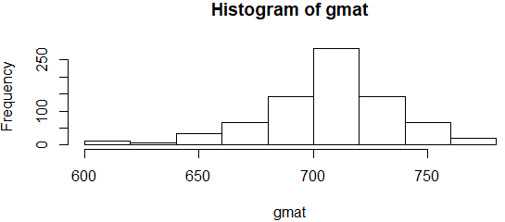
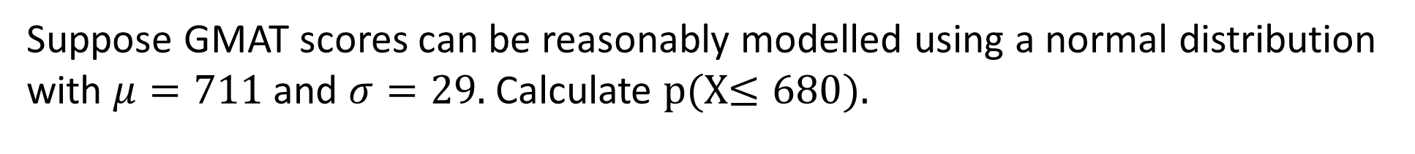
Calculating Probability from Z-distribution
Suppose GMAT scores can be reasonably modelled using a normal distribution with $μ=711$and $σ=29.$Calculate p(X$≤680)$.
1→ Calculate Z-score corresponding to 680.
Z= (680-711)/29= -1.06
2→ Calculate probabilities using Z-tables.
P(Z-1)=0.14

Slide 25
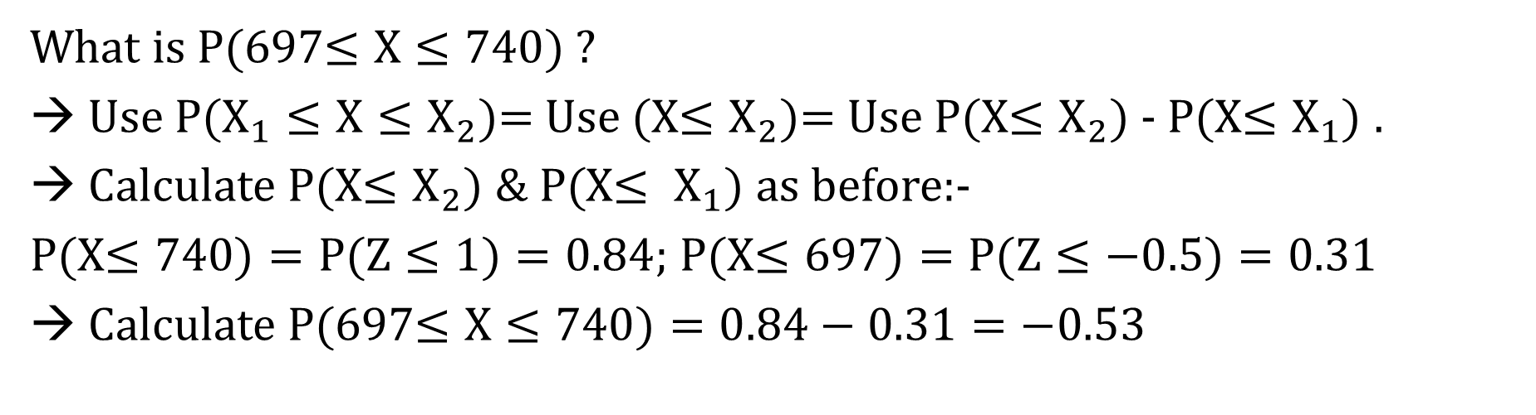
Calculating Probability from Z-distribution
What is P(697$≤X≤740)$?
→ Use P($X_{1}≤X≤X_{2}$)= Use (X$≤X_{2})$= Use P(X$≤X_{2})$ - P(X$≤X_{1})$ .
Calculate P(X$≤X_{2}) \& P($X$≤ X_{1}$) as before:-
P(X$≤740)=P(Z≤1)=0.84$; P(X$≤697)=P(Z≤−0.5)=0.31$
→ Calculate P(697$≤X≤740)=0.84−0.31=−0.53$

Slide 26
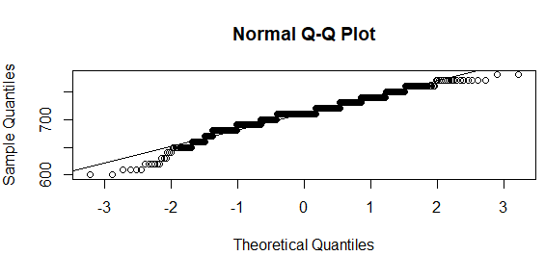
Normal Quantile Plot

